Slide 1
Imagination Works…

Slide 2
Company Profile
Hi All,
We are proud to introduce to you Advantage Enterprises as one of the leading service providers in the domain of
FABRIC LASER CUTTING.
Empowered with high-quality Lasers & Matching Manpower, we at Advantage Enterprises, offer prompt response, customization as per the client’s needs, and at the same time assure punctual delivery for all Fabric Laser Cutting requirements. We offer an array of services to help our clients in achieving their production goals and establishing their market presence. We make sure that each Product/Service fulfills the specifications and quality standards as prescribed and desired by our respective clients.
At Advantage Enterprises, it is our spirit to take responsibility for the strict and on-time delivery of our services. We make sure that products get dispatched as soon as possible at the respective destination, within the stipulated time frame.
Advantage Enterprises is dedicated to delivering high-quality products and a superior Customer Service to our clients.

Slide 3
We specialize in the following Laser Cutting Services:
3. JEANS PATCH CUTTING
2. LEATHER/ PU CUTTING
1. FABRIC CUTTING
4. PATTERN CUTTING FOR SWAROVSKI STONES SHEETS
5. BUTTON MARKING
6. DESIGNER BUTTON/ POLYESTER/ PLEXIGLASS BELT BUCKLES
7. FOAM CUTTING
8. FELT FABRIC/ GUMMED FELT FABRIC CUTTING
9. SPORTS CLOTHING PANEL PATTERN

Slide 5
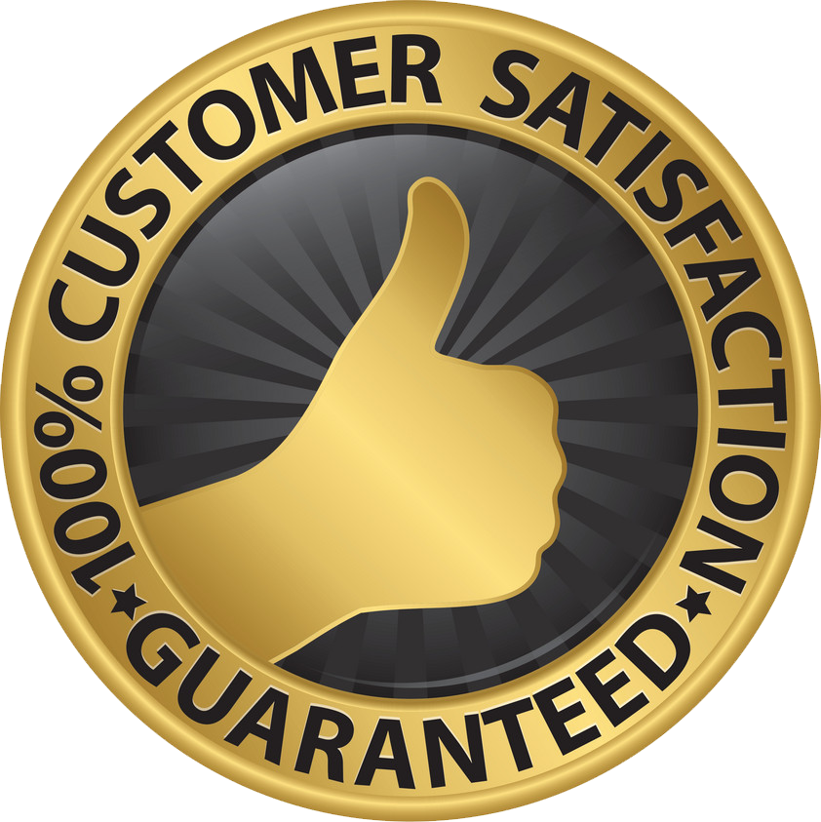
1. Assured Quality
We Assure 100% Adherence to our respective Client’s Design Guidelines. In addition to it, we aim to provide high-quality products that meet our client’s expectations. At Advantage Enterprises, Satisfaction of our clients is our utmost Priority.

Slide 6
2. Promise
We take care of Timely Delivery of Processed Fabric, Leather, PU, Buttons and more. We work on providing delivery of the specified products within the stipulated time frame.

Slide 7
3. Team work
We are a Team of Dedicated Young Professionals, who are always ready to go the Extra Mile for Achieving the Desired Results.

Slide 8
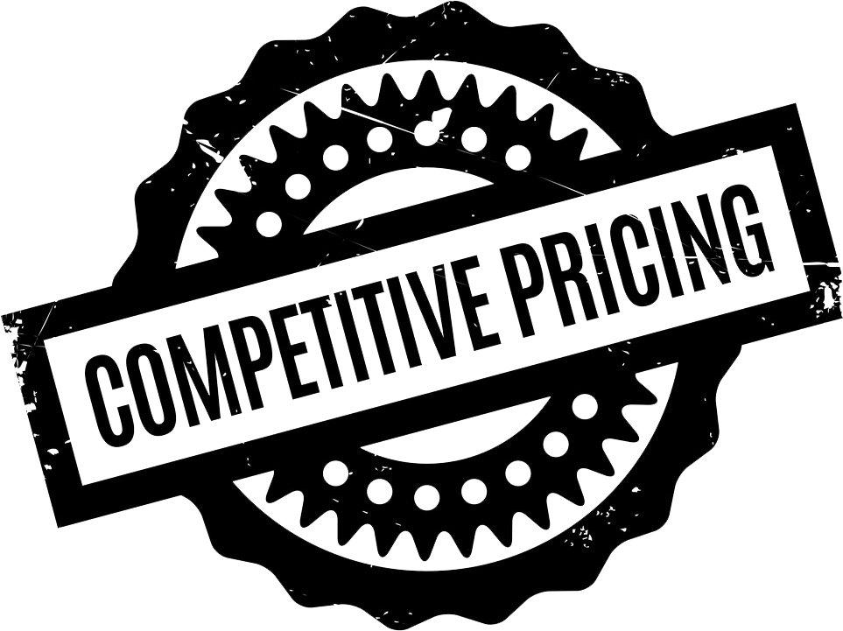
4. Price
We Ensure Quality Services @ Reasonable Price.

Slide 9
OUR SETUP
LASER CUTTING HARDWARE SETUP
EPILOG CO2 DUAL HEAD MACHINE
SIZE - 1400MM X 1000MM UPTO ROLL TO ROLL
100 WATTS X 2 SUPERIOR CUTTING POWER
PENTIUM CORE i5 7TH GENERATION PC’S
CUTTING PLOTTER 48 INCH
ONLINE 5 KVA UPS SYSTEMS
SOFTWARE: RD WORKS-V8
FILE TYPES: AI, DXF, PLT, CDR, SVG

Slide 10
Imagination Works…
The following slides contain an insight into the services we render in the field of Laser Cutting.

Slide 11
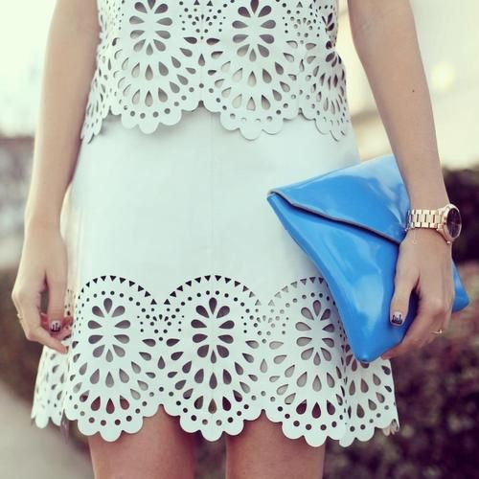
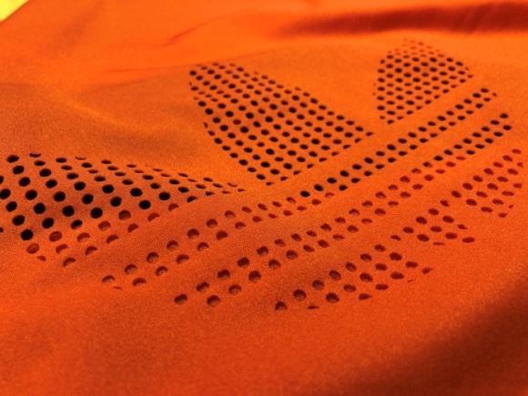
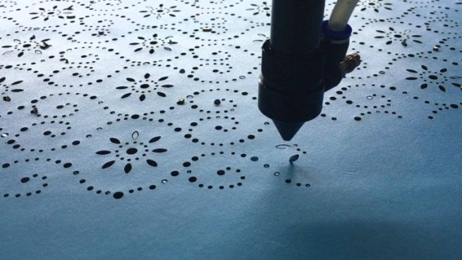
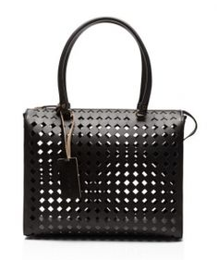
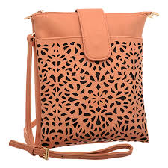
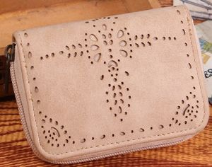
FABRIC CUTTING SAMPLES
LEATHER/ PU CUTTING SAMPLES

Slide 12
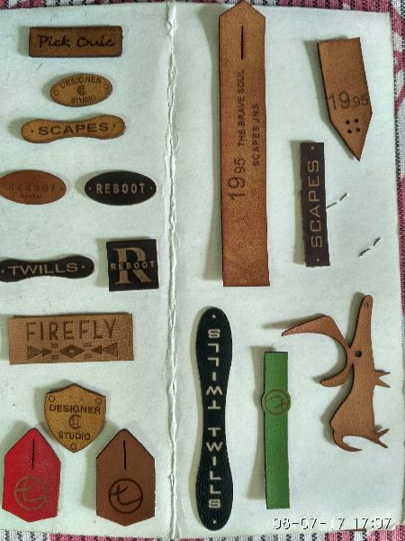
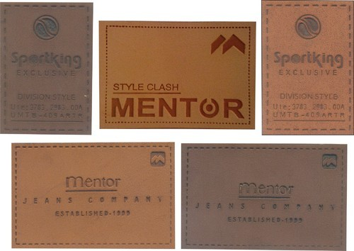
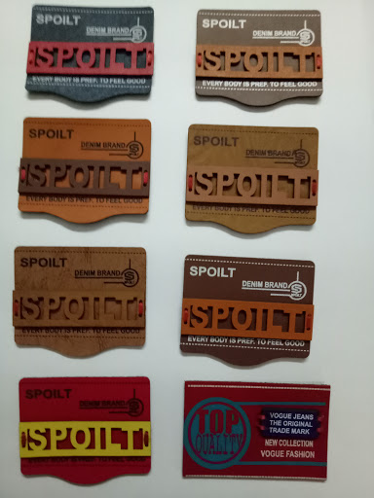
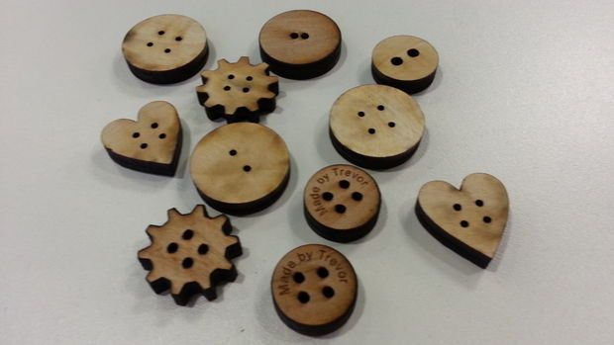
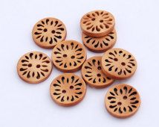
JEANS PATCH CUTTING SAMPLES
16L/84L BUTTON MARKING SAMPLES

Slide 13
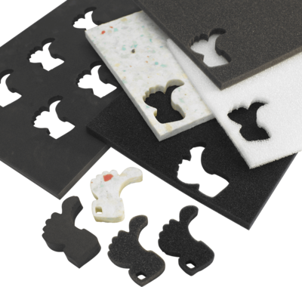
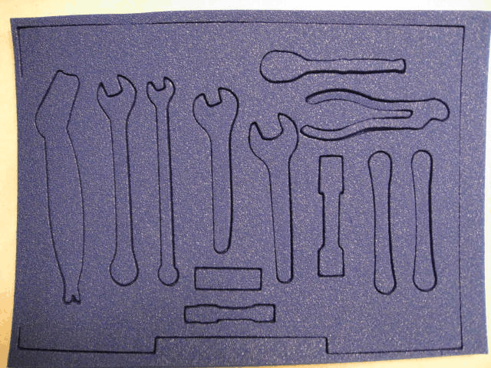
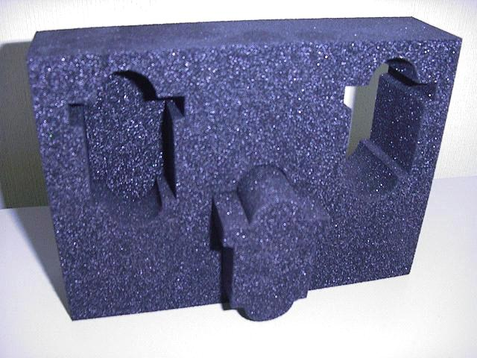
FOAM CUTTING SAMPLES

Slide 14
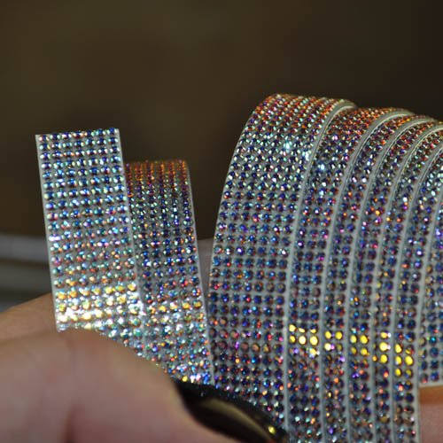
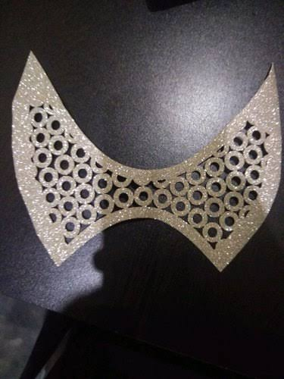
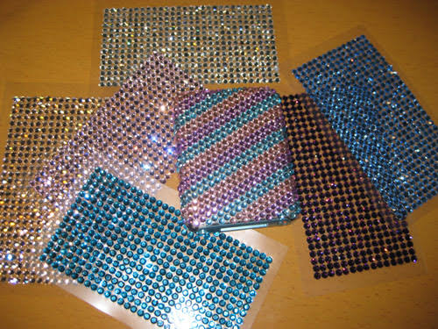
PATTERN CUTTING: SWAROVSKI STONES SHEETS SAMPLES

Slide 15
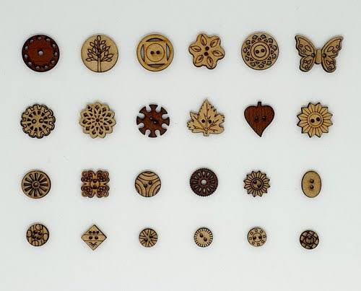
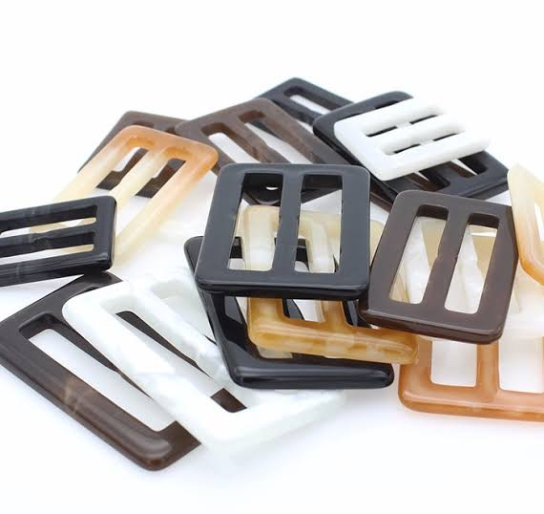
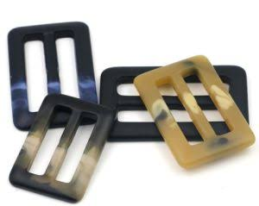
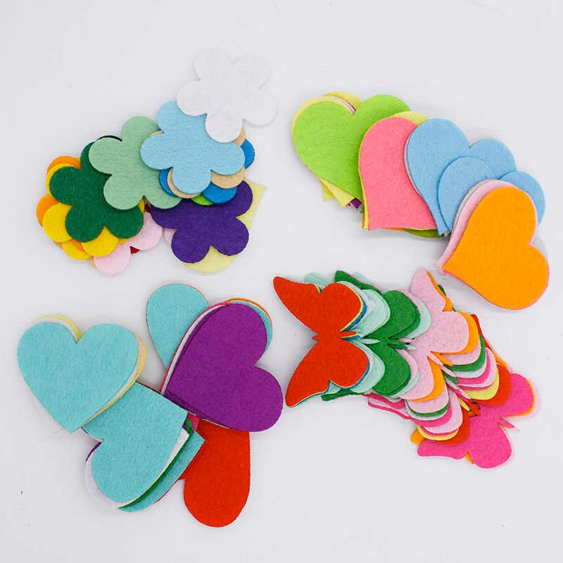
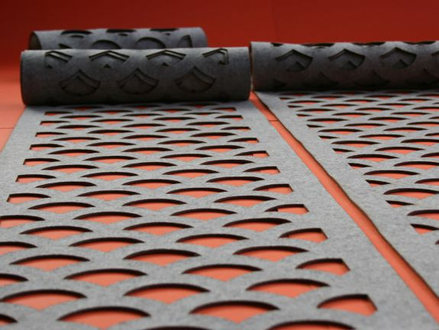
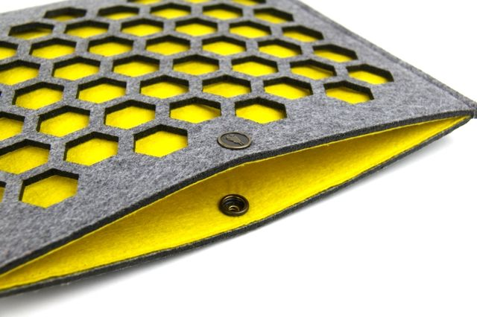
DESIGNER BUTTON/ POLYESTER BELT BUCKLES SAMPLES
FELT FABRIC/ GUMMED FELT FABRIC CUTTING SAMPLES

Slide 16
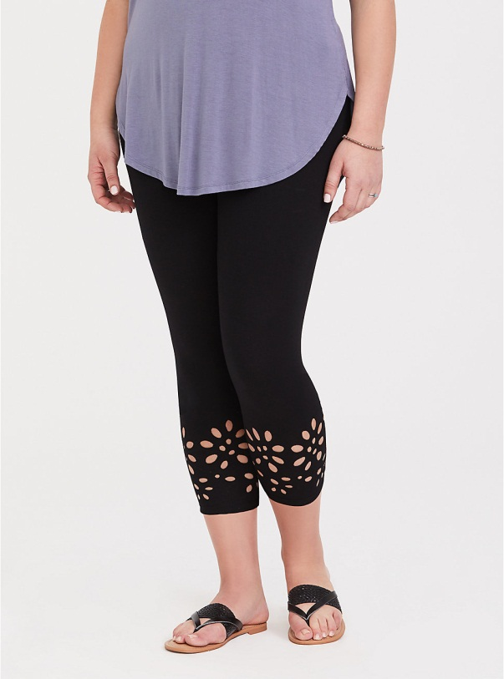
SPORTS CLOTHING PANEL PATTERN SAMPLES

Slide 17
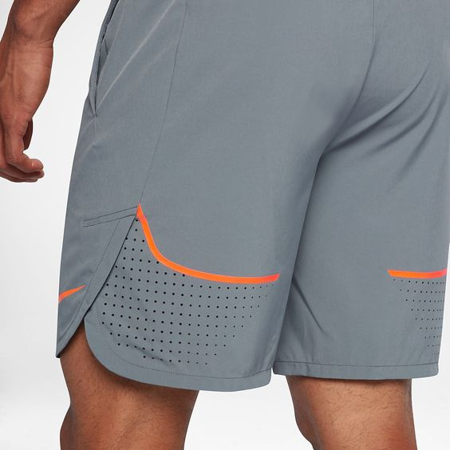
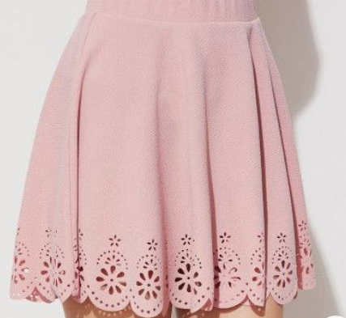
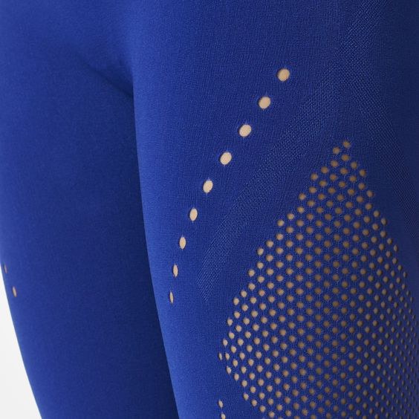
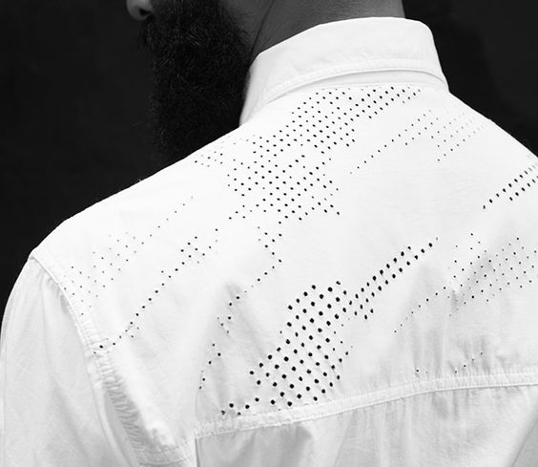
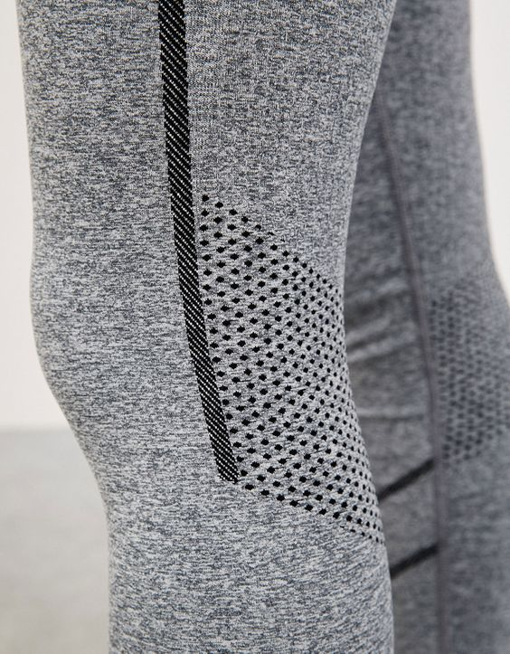
SPORTS CLOTHING LASERCUT PATTERN SAMPLES

Slide 18
Imagination Works…
Work Place: A-26A 2nd Floor,
Mayapuri Industrial Area Phase-II,
New Delhi - 64 ( Near Nexa Showroom).
Mobile no. : +91-98737 98161
Email id: AdvantageOne@Zoho.com
Www.LaserCuttingWork.com

